Slide 1
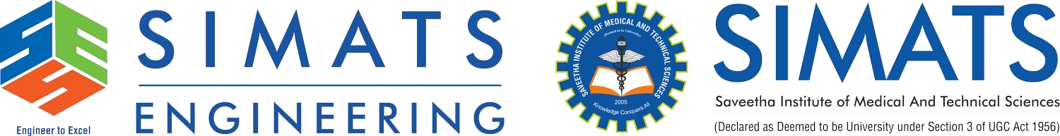
Cloud Migration Strategies: Moving Enterprise Applications to the Cloud
COURSE: Cloud Computing and
Big Data Analytics
CODE: CSA1513
COURSE FACULTY: Dr Antony Joesph Rajan
NAME: SANDEEP K
REG NO: 192521253

Slide 2


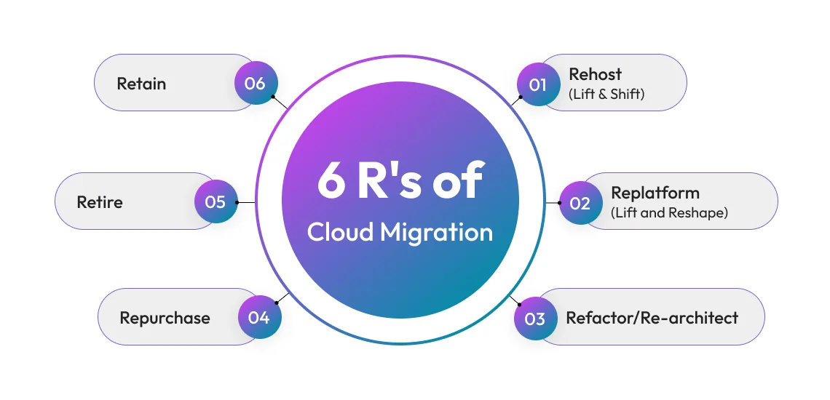
Cloud Migration Strategies
Cloud migration is the process of moving applications, data, and IT resources from on-premises servers to cloud platforms like AWS, Microsoft Azure, or Google Cloud. This presentation explains why organizations migrate to the cloud, the strategies used, and a successful real-world implementation.
Objectives
Understand cloud migration.
Learn different migration strategies.
Explore migration architecture.
Study benefits and challenges.
Analyse a real-world migration example.

Slide 3
What is Cloud Migration?
Cloud migration means transferring:
Applications
Databases
Files
Virtual Machines
Business services
from
On-Premise Data Centre ↓
to
Cloud Platform
Popular Cloud Providers
Amazon Web Services (AWS)
Microsoft Azure
Google Cloud Platform (GCP)
Why Companies Migrate?
Lower infrastructure cost
Better scalability
High availability
Disaster recovery
Improved security
Remote accessibility

Slide 4
Cloud Migration Strategies (THE 6 RS)
Migration Strategies
Strategy | Description
Rehost | Move application without changing it (Lift & Shift)
Replatform | Make small improvements before migration
Refactor | Redesign application to fully utilize cloud features
Repurchase | Replace with SaaS software
Retire | Remove unused applications
Retain | Keep application on-premises temporarily
Most Common Strategy
Rehost (Lift and Shift)
because
Fast
Low cost
Minimal changes

Slide 5
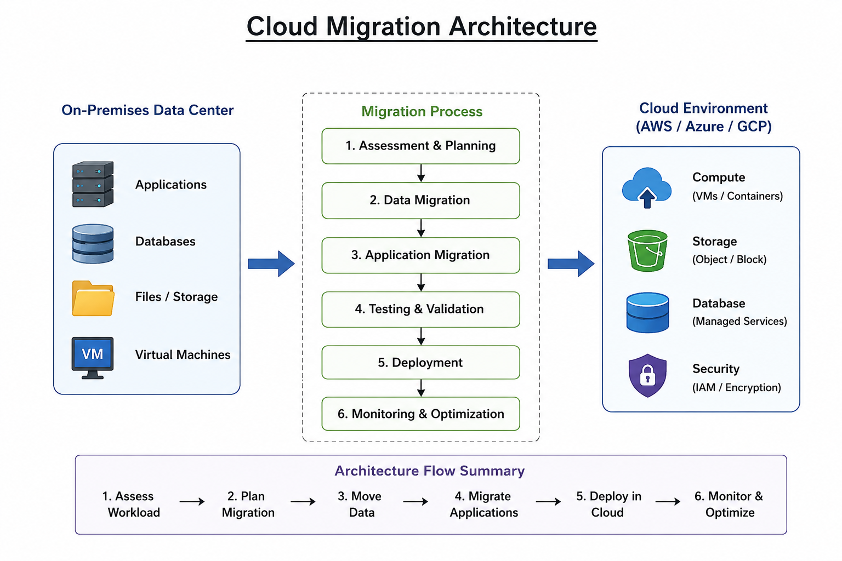
CLOUD MIGRATION ARCHITECTURE

Slide 6

Industry Relevance & Real-World Use Case
Netflix Cloud Migration
Before
Own data centres
Hardware failures
Scalability issues
After migrating to AWS
Serves over 300 million users globally
Auto scaling
High availability
Faster deployment
Global content delivery
Benefits
✔ Reduced downtime
✔ Better customer experience
✔ Elastic scaling during peak hours

Slide 7
Benefits, Challenges & Limitations
Benefits
Reduced cost
Faster deployment
Scalability
Disaster recovery
Improved security
Better collaboration
Challenges
Data security concerns
Downtime during migration
Application compatibility
Employee training
Limitations
Internet dependency
Migration complexity
Compliance requirements
Cost overruns if not managed

Slide 8
Conclusion & Future Scope
Conclusion
Cloud migration enables organizations to modernize IT infrastructure, improve scalability, reduce operational costs, and enhance business continuity.
Future Scope
AI-assisted cloud migration
Multi-cloud environments
Hybrid cloud adoption
Serverless computing
Edge computing integration
Green cloud computing

Slide 9
THANK YOU

Slide 10
